Slide 1

The Changing Face of
Investment Products & Opportunities: Alternative Investments
NASAA 2014 Investor Education Training
May 2, 2014
St. Louis, Missouri
Andrea Seidt Joseph Brady
NASAA President NASAA General Counsel
Ohio Securities Commissioner

Slide 2
What is an alternative investment?
There is no universally accepted definition of alternative investments, but the term typically refers to an investment in asset classes other than the traditional classes of stocks, bonds, cash, and cash equivalents.
It can be something as simple as an investment in a single asset class like gold, art, and coins or can be an investment in a very complex investment product or strategy like pooled investment vehicles, structured products, and direct participation programs like REITs and oil and gas partnerships.

Slide 3
Alternatives are big business.
According to Towers Watson Consulting Group, the amount of total alternative assets under management in the world topped $5 trillion in 2012.
About half of alternatives reported in the survey were held in hedge funds. Hedge fund assets under management (AUM) grew to a record $2.6 trillion in 2013.
Private equity fundraising was also strong, raising more than $600 billion in 2013.
According to Morningstar, alternatives are also the fastest growing mutual fund category with assets totaling $216.5 billion in 2013 from a total of 402 funds, compared to only $11.2 billion from a total of 77 funds a decade earlier.

Slide 4
Who’s selling?
Among the top 100 alternatives firms:
  real estate managers are the biggest players, controlling over a third of reported alternative assets (34%),
  direct private equity fund managers (23%),
  direct hedge funds (20%),
  private equity funds of funds (10%),
  funds of hedge funds managers (6%),
  infrastructure managers (4%) and
  commodities managers (4%).

Slide 5
Who’s buying?
Practically everyone due to the “mainstreaming” of alternatives. Morningstar reports “only 4% of advisors said their typical client had no money in alternative investments, down from 17 percent in the 2008 survey.”
Institutional investors are still the largest contributors according to the Towers Watson survey: pension funds contribute more than one-third (36%) of the top 100 alternative managers’ assets, followed by wealth managers (19%), insurance companies (9%), sovereign wealth funds (6%), banks (5%), funds of funds (3%) and endowments and foundations (2%).
North America is the prime destination for alternative capital (46%), followed by Europe (37%) and the Asian-Pacific region (10%).

Slide 6
What are some common features?
Specific features depend on the particular terms and conditions of the alternative investment product or strategy, but alternatives are generally regarded as posing higher risk to retail investors than traditional investment products due to:
  complexity,
  leverage,
  transparency,
  volatility, and
  illiquidity.

Slide 7
Complexity.
Many alternative investment products have multiple features that affect investment returns and can be difficult for even an experienced investor to understand.
Gains and losses can be contingent on certain future events through embedded derivative components.
Structured products, in particular, often employ complicated limits or formulas for calculating gains.

Slide 8
Leverage.
Leverage is the use of financial instruments or borrowed funds to amplify performance. In an upward- or downward-trending market, a leveraged investment that is on the correct side of the trend will see magnified gains, while one on the wrong side of the trend will see magnified losses.
Most often it involves buying more of an asset by using borrowed funds, with the belief that the income from the asset will be more than the pay for the cost of borrowing. The risk is borrowing costs may be larger than the income from the asset – causing a reduction in profits.

Slide 9
Transparency.
Transparency is the ability to clearly see and understand exactly what you are investing in.
Alternatives are not transparent for several reasons. There is limited or no historical risk and return data. There is typically no public exchange or readily available secondary market to help investors value or price their investments.
In the extreme, alternatives can consist of blind pool investments with no stated investment goal for the investor funds and no identifiable assets upon which the investment is based.

Slide 10
Volatility.
Volatility is the variation in the performance of an investment commonly measured by standard deviation relative to a mean or benchmark.
High volatility is depicted by wide swings in performance, making it difficult to anticipate the outcome of an investment over the long term.

Slide 11
Liquidity.
Liquidity is the ability of an investor to liquidate by selling, cashing or transferring out of an investment. Many alternative investments are illiquid due to long-term holding periods. Other alternatives are illiquid due to restrictions on resale and the lack of a deep secondary market.

Slide 12
What are the risks?
Again, specific risks depend on the specific terms and conditions of the alternative investment product or strategy, but some common risks include:
  Loss of all or a substantial portion of the investment
  Lack of liquidity
  Volatility of returns
  Restrictions on transferring interests
  Absence of information regarding valuation and pricing
  Delays in tax reporting
  Conflicts of interest
  Less regulation and higher fees than traditional mutual funds
  Risks associated with operations, personnel, and processes of manager

Slide 13
Why are investors turning to alternatives?
Many investors are chasing yield in this low interest rate environment – and many alternatives are sold for yield and income-producing dividends.
Investors also invest in alternatives to diversify their portfolios in the hopes of offsetting losses during a market downturn.
Alternative investments generally have a low correlation with traditional investment products, which means they should not follow the same track – dips and spikes – observed in the stock and bond market.

Slide 14
Example of low yield environment – yield on 2 year Treasuries since the financial crisis.
rr

Slide 15
A look at specific alternative products.

Slide 16
Annuities
Annuities
Commentary
A contract between a person and an insurance company that requires the insurer to make payments, either immediately or in the future.
Fixed annuity. The insurance company promises a minimum rate of interest and a fixed amount of periodic payments.
Variable annuity. The insurance company allows a person to direct payments to different investment options, usually mutual funds. The payout will vary depending on how much is put in, the rate of return on investments, and expenses.
Indexed annuity. Combines features of securities and insurance products. The insurance company credits the owner with a return that is based on a stock market index, such as the S &P 500.
State regulators have issued investor alerts and in some cases taken enforcement actions related to annuities sales programs.
“Free lunch seminars” are usually nothing more than high pressure sales tactics.
State regulators have taken enforcement actions against firms and individuals for the sale of unsuitable variable annuity products.

Slide 17
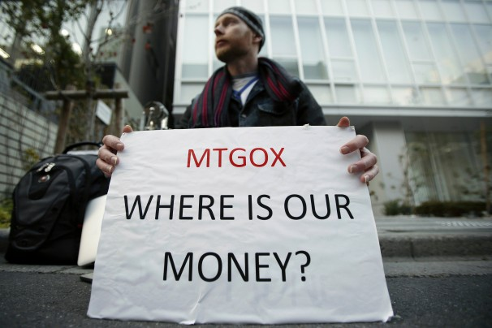
Bitcoin and Digital Currency
Bitcoin
Commentary
Bitcoin is a digital , virtual, or crypto- currency created as a peer-to-peer payment system. Code was created in 2009 by developer Satoshi Nakamoto.
Bitcoins are created as a reward for payment processing work in which users who offer their computing power verify and record payments into a public ledger. Called mining, individuals engage in this activity in exchange for transaction fees and newly minted bitcoins.
Besides mining, bitcoins can be obtained in exchange for other currencies, products, and services. Users can buy, send, and receive bitcoins electronically for a nominal fee using wallet software on a personal computer, mobile device, or a web application.
http://www.washingtonpost.com/blogs/the-switch/wp/2014/02/25/everything-you-need-to-know-about-the-latest-bitcoin-crisis/

Slide 18
Private Placements
Private Placements
Commentary
The sale of securities to a relatively small number of select investors as a way of raising capital.
Reg D deals are the most common private placement vehicle.
Investors involved in private placements are usually large banks, mutual funds, insurance companies and pension funds.
Private placement is the opposite of a public issue, in which securities are made available for sale on the open market.
Enforcement cases involving private placements, and more specifically Regulation D, Rule 506 offerings, regularly take the number 1 spot on the NASAA enforcement survey.
Recent examples of private placement fraud:
  Stanford International Bank running a massive Ponzi scheme and offering phony CDs via private placement deals totaling $2.7 billion.
  Provident Royalties, LLC engaging in fraud and Ponzi scheme related to $485 million in oil and gas limited partnerships
  Medical Capital Holdings Inc. engaging in fraud accounting for an estimated $1.2 billion in investor losses from the sale of private securities in the form of notes on medical receivables.
  DBSI Inc. promoting a $600 million Ponzi scheme related to the sale of fraudulent tenants-in-common real estate exchange products.

Slide 19

Crowdfunding
Crowdfunding
Commentary
Crowdfunding is funding through a large pool of backers—the "crowd"—usually online through a web platform.
4 types
  Donation-based in which the backers essentially donate money to support a cause.
  Reward-based in which the backer receives a reward with a clear monetary value in exchange of the pledge. The reward is often a product or a pre-series item that the backer helped producing by pledging money.
  Credit-based in which the backer lends the money and receives an interest rate in exchange.
  Equity-based in which the backer receives shares of a company in exchange of the money pledged. In this case the money is pledged in the form of risk capital.
http://crowdfundingheroes.com/fun/cartoon-no-i-dont-think-nasa

Slide 20
Multi-level Marketing (MLM)
Multi-level Marketing (or Network Marketing)
Commentary
In an MLM program, commissions are paid for products or services that you and the distributors in your "downline" (i.e., participants you recruit and their recruits) sell to others.
Some programs purport to be MLM but are in fact pyramid schemes.
Legitimate MLM opportunities involve the payment of commissions involving the sale of products to third parties.
Pyramid schemes make money primarily through signing up new recruits to purchase a package of goods or services and not from product sales.
Recent regulatory actions filed against Telexfree.

Slide 21

Hedge Funds
Hedge Fund
Commentary
Private pools of investment capital
Broad flexibility to buy or sell a wide range of assets
Seek to profit from market inefficiencies – often use leverage
Advisers to hedge funds may be required to register or file reports with one or more U.S. jurisdictions or the SEC.
http://hf-implode.com/

Slide 22
Non-Traded REITs
Non-Traded REITS
Commentary
A form of real estate investment method that is designed to reduce or eliminate tax while providing returns on real estate.
A non-traded REIT does not trade on a securities exchange and is quite illiquid for long periods of time.
Front-end fees can be as much as 15%, much higher than a traded REIT due to its limited secondary market.
State regulators in Massachusetts initiated enforcement actions against 6 BDs for violations involving non-traded REITs. The firms settled the cases by offering restitution to investors and paid fines of nearly $1.5 million.
Ohio regulators took an enforcement against Steadfast Income REIT.

Slide 23
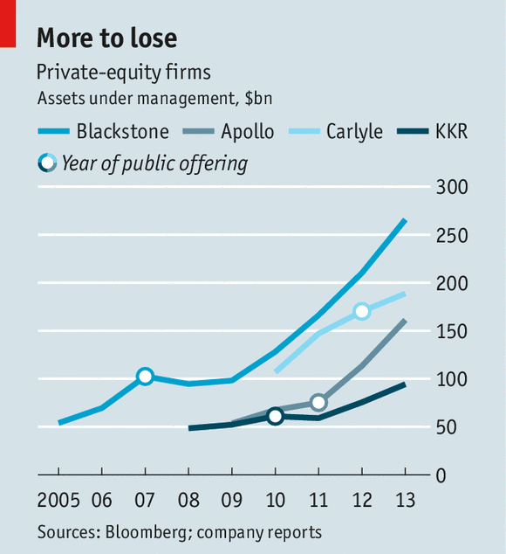
Private Equity Funds
Private Equity Funds
Commentary
Ownership of company that is not publicly owned, quoted or traded on a stock exchange.
Targeted to a company, helping it grow, change, finance an acquisition, or go public.
http://www.economist.com/news/finance-and-economics/21600982-firms-pioneered-private-equity-are-becoming-duller-barbarians-middle

Slide 24
Business Development Companies (BDCs)
Business Development Companies
Commentary
Regulated, closed-end investment firms that make loans to, and/or invest in small, developing, or financially troubled companies. They’ve stepped into a role than commercial banks vacated during the financial crisis, lending to companies that may not otherwise get financing.
BDCs are very similar to venture capital funds, but can be sold to retail investors. Many BDCs are set up much like closed-end investment funds and are actually public companies that are listed on the NYSE, AMEX and Nasdaq.
Investors buy a piece of the fund reaping the full returns of its investments instead of simply the management company’s share as is the case with traditional venture capital funds.
Today, there are more than 40 business development companies with $40 billion in assets and $25 billion in market capitalization.

Slide 25
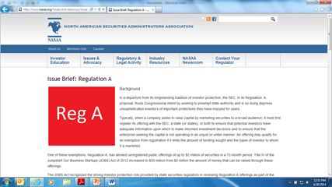
Regulation A+
Regulation A+
Commentary
A new exemption from the registration requirements of the Securities Act of 1933 that would permit nonpublic companies to conduct securities offerings of up to $50 million in any rolling 12-month period.
Passed as part of the JOBS Act and is designed to provide greater access to small businesses by creating a bridge from private placements to public offerings.
http://www.nasaa.org/issues-and-advocacy/issue-brief-regulation-a/

Slide 26
Oil & Gas Partnerships
Oil and Gas Partnerships
Commentary
Oil and gas investments take many forms, including limited partnership interests, ownership of fractional undivided interests in leases, and general partnerships.
True general partnerships in which investors actively participate in the operations of the venture are not securities.
In a drilling limited partnership, an oil or gas company sells partnership units to investors and uses the money it raises to lease property and drill wells. In return for managing the project, the sponsor company usually takes an upfront fee that averages about 15-16% of one’s investment (commonly referred to as tangible and intangible drilling costs) and also shares in a percentage of any revenue generated. In return, the promoter offers the investor the prospect of a substantial first year tax write-off and quarterly cash distributions from the sale of any oil and gas the partnership finds until the wells run dry.
Enforcement actions involving investments in oil and gas ventures also regularly appear on the NASAA enforcement survey.
It is not uncommon for promoters to structure the deals as “general partnerships” or “joint ventures” in order to evade the review and registration process of the securities laws.

Slide 27

Derivatives
Derivatives
Commentary
Contracts entered into for the purpose of exchanging value on underlying securities or assets.
Used for operational efficiency or to control transaction costs.
Security whose income payments and value is derived from and collateralized (or "backed") by a specified pool of underlying assets.
The pool of assets is typically a group of small and illiquid assets which are unable to be sold individually. Pooling the assets into financial instruments allows them to be sold to general investors, a process called securitization, and allows the risk of investing in the underlying assets to be diversified because each security will represent a fraction of the total value of the diverse pool of underlying assets.
ABS – Asset-backed securities
MBS – Mortgage Backed Securities
CDO – Collateralized Debt Obligations

Slide 28
Futures
Futures
Commentary
Futures are standardized financial contracts between two counterparties where buyer agrees to buy an underlying asset at a pre-determined future date and price.
Often used in conjunction with long/short strategy. Invest long on assets expected to increase in value; short assets expected to decrease.
State regulators see commodity-related frauds usually involving precious metals or foreign currencies.
At the federal level, the Commodity Futures Trading Commission (CFTC) is charged with regulating transactions involving commodities and futures.

Slide 29
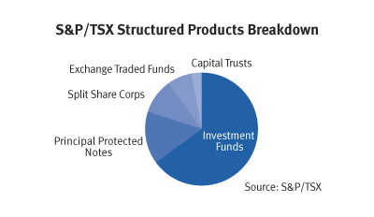
Structured Products
Structured Products
Commentary
Investment vehicles based on a single security, a basket of securities, an index, a commodity, a debt issuance and/or a foreign currency.
Have a fixed maturity date and are designed to offer specific risk-return tradeoffs, with complex pre-set formulas for both the potential risk and potential return.
Some offer protection of the principal–when held to maturity, subject to issuer credit risk, thus offering a lower risk than investing in the underlying asset directly. Others do not guarantee principal, but may provide a partial buffer against loss or offer the potential for enhanced returns.
https://www6.royalbank.com/educationcentre/english/alternative-investments/structured-products.html

Slide 30
Principal Protected Notes
Principal Protected Notes
Commentary
Also known as Guaranteed Linked Notes
Investment contracts with a guaranteed rate of return of at least the amount invested, and a possible gain.
Typically, PPNs guarantee 100% of invested capital, as long as the note is held to maturity. That means, regardless of market conditions, investors receive back all money they invested.
Investors need to review terms to understand situations where protection is conditioned or can be withdrawn by product sponsor.
http://www.forbes.com/sites/johnwasik/2013/11/18/principal-protection-pitfalls-six-questions-to-ask/#./?&_suid=139887925636605121801196855794
How do I know whether this product is appropriate for me given my overall investment objectives?
What is the level of principal protection offered? Are there conditions to the principal protection?
What are the fees and other costs?
How long will my money be tied up?
Can I sell or liquidate before the maturity date?

Slide 31
Reverse Convertible Notes
Reverse convertible note
Commentary
Short-term debt securities, typically with a one year maturity. At maturity, the owner receives either 100% of their original investment or a predetermined number of shares of the underlying stock, in addition to the stated coupon payment.
Coupon payments are the obligation of the issuer and are paid on a monthly or quarterly basis. These instruments are sold by prospectus or offering circular, and prices on these notes are updated intra day to reflect the activity of the underlying equity.
The general rule of thumb is: The higher the coupon payment, the greater likelihood of receiving stock at maturity.
In 2010 FINRA ordered Ferris Baker Watts, a subsidiary of RBC, to pay a $500,000 penalty and almost $200,000 in restitution for violations of FINRA rules involving sales of reverse convertibles. Included in the violations were unsuitable sales to seniors.

Slide 32
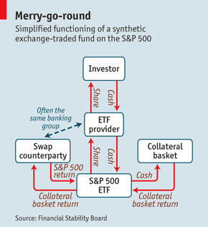
Exchange Traded Funds (ETFs)
Exchange Traded Funds
Commentary
A security that tracks an index, a commodity or a basket of assets like an index fund, but trades like a stock on an exchange.
ETFs experience price changes throughout the day as they are bought and sold.
http://www.economist.com/node/18864254

Slide 33
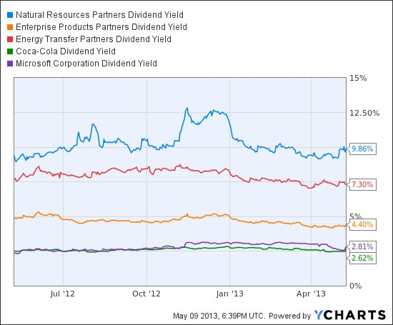
Exchange Traded Notes (ETNs)
Exchange Traded Notes
Commentary
A type of unsecured, unsubordinated debt security that was first issued by Barclays Bank PLC.
Differs from other types of bonds and notes because ETN returns are based upon the performance of a market index minus applicable fees, no period coupon payments are distributed and no principal protections exists.
http://finance.yahoo.com/news/exchange-traded-notes-high-yields-150850411.html

Slide 34
Tenant In Common Interests (TICs)
Tenant in Common Interests
Commentary
The co-owners of an undivided interest in real property, typically commercial property. Tenants in common each own a separate and undivided interest in the same real property and each has an equal right to the possession and use of the property.
Upon the death of one tenant, his or her undivided interest passes to heirs through a probate proceeding; the interest does not pass to another tenant in common unless the surviving co-owner is an heir or a purchaser.
One of the biggest distributors of TICs, DBSI, Inc., filed for bankruptcy in 2008. Prior to becoming insolvent, investors in all 50 states had put approximately $1 billion into DBSI’s TIC investments.
Subsequent investigations into DBSI’s financials revealed that the company had begun to experience major liquidity issues beginning as early as 2004. DBSI would later fail to pay investors their dividends out of legitimate rents from the new properties; instead, it issued payments from profits made by marking up various properties and then selling them at inflated prices to unsuspecting investors.
In April 2014 former executives of DBSI were convicted of numerous counts of wire and securities fraud.

Slide 35
1031 Exchanges
1031 Exchanges
Commentary
A 1031 exchange is a real estate transaction involving the sale of one property with the tax on the capital gain deferred because of the qualified purchase of another like-kind property in exchange. For 1031 exchange purposes, the term like-kind property is interpreted as any type of investment property, rather than property owned for personal use.
The 1031 exchange rules continue to be refined. Although the 1031 exchange rules are somewhat complex, the effect of breaking them is straight forward. If the IRS determines there was no valid 1031 exchange, sales proceeds may be subject to capital gains tax.
Dodd-Frank directed the CFPB to study 1031 exchanges and “exchange facilitators.”
An “exchange facilitator” is a person who works with a consumer in the conducting a 1031 exchange.
The study was likely prompted by failures, misappropriations, and bad investments related to “exchange facilitators.”
CFPB report found limited instances of bad conduct and made no recommendations for further regulation.

Slide 36
Are alternatives suitable for every investor?
No, alternatives are not for everyone. They are often speculative investments in which an investor may lose all or part of his or her investment. They are not suitable for investors seeking to conserve capital.
Typically geared toward wealthy, sophisticated individual investors and institutional investors who are seeking aggressive growth and income.
There are state-issued and firm-recommended restrictions on how much of certain investments can be sold to individual investors, per product and in the aggregate, based on investor net worth.
Generally, an investor should invest no more than 5-10% in any single alternative investment product or strategy; no more than 10-20% in the aggregate for all alternatives.

Slide 37
What should investors interested in alternatives ask?
Investors need to understand the product or strategy before they invest, they should ask:
  What are the key features – benefits and risks?
  What are the fees – is there a better, lower cost option?
  How is the product or strategy expected to perform – is it possible to lose all or part of the investment?
  What are the scenarios where the product or strategy might perform poorly?

Slide 38
What about senior investors?
Some broker-dealer and investment advisory firms have special rules regarding recommendations of alternative investment products or strategies to senior investors.
May not be appropriate for investors over age 70.
Firms also look to the investor’s health status, near term financial needs, succession arrangements to make suitability determinations.

Slide 39
QUESTIONS?
Joseph Brady jb@nasaa.org (202) 737-0900
Andrea Seidt andrea.seidt@com.ohio.gov (614) 644-7435

